Slide 1
Network Effects and the Diffusion of Communications
Technologies and Computer Hardware and Software
Jean Bella
Fayyaz M Adil

Slide 2
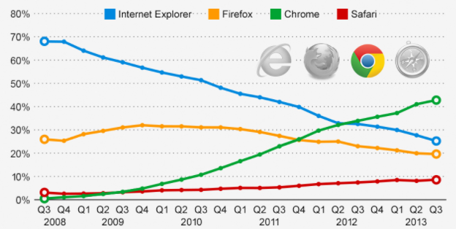
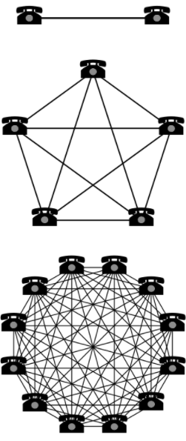
CASE SURVEY
A network effect (or network externality or demand-side economies of scale) is the effect described in economics and business that an additional user of goods or services has on the value of that product to others.
Network effect of Google chrome

Slide 3
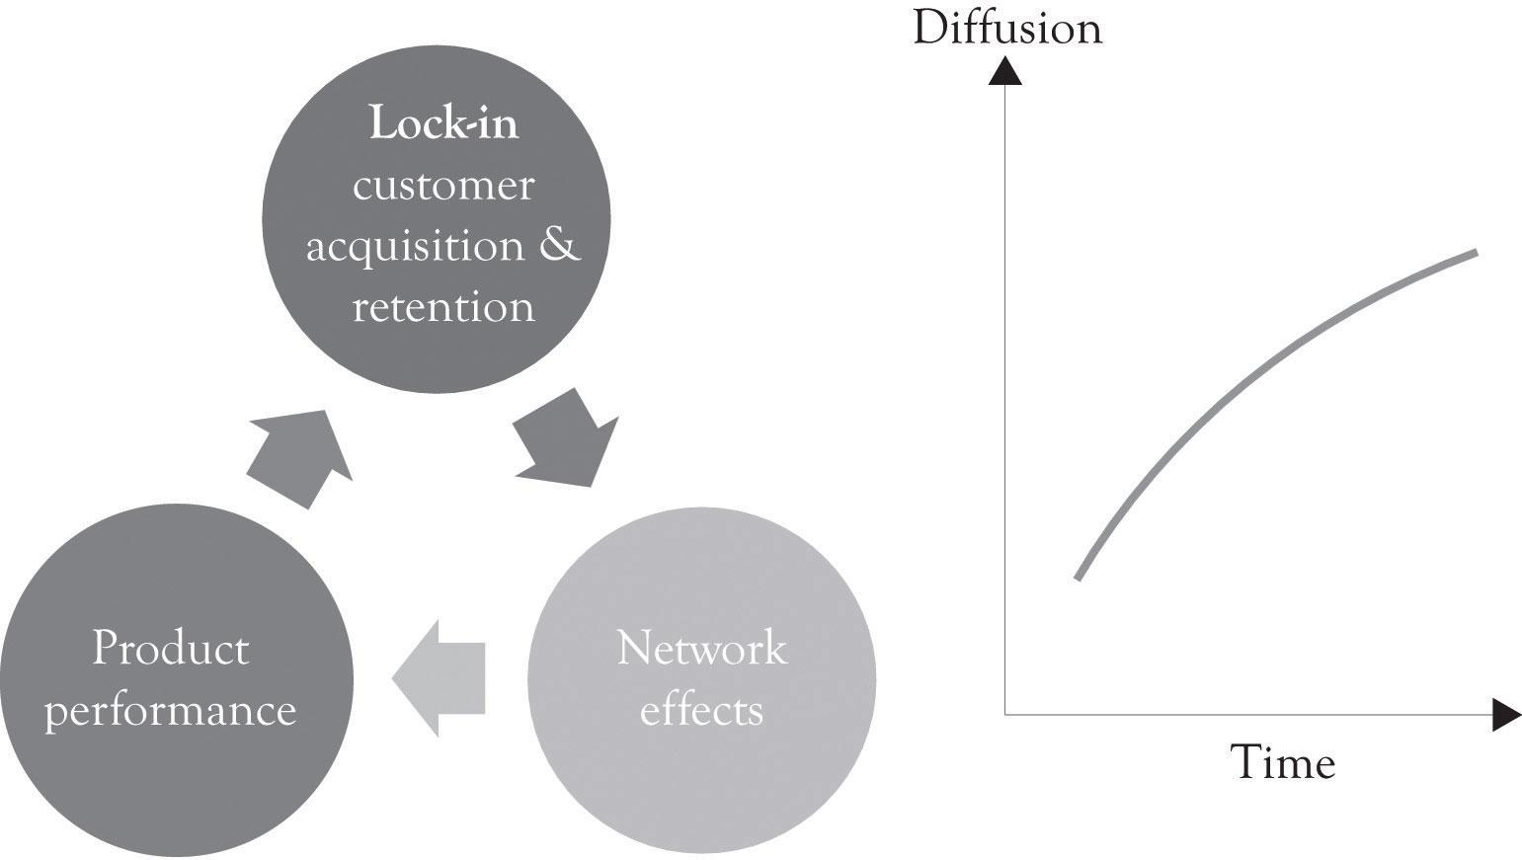
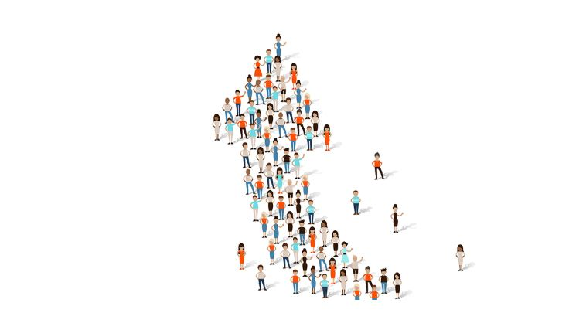
DEFINITION OF THE ECONOMICS TERMS AND NOTIONS
Bandwagon effect
A psychological phenomenon in which people do something primarily because other people are doing it, regardless of their own beliefs, which they may ignore or override.
Lock-in effects
A practice, where a company makes it extremely hard for their customers to leave them, even if the customer wants to.
Critical mass phenomena
Critical mass is a sufficient number of adopters of a new idea, technology or innovation in a social system so that the rate of adoption becomes self-sustaining and creates further growth.
Diffusion
A theory that seeks to explain how, why, and at what rate new ideas and technology spread.

Slide 4
ECONOMIC MODELING
WhatsApp Vs. Facebook
tweaking the product to get the right fit
The factors that led FaceBook to the top
Clustered approach
extremely high bar of engagement before expanding
Novel Media for Global Communication
sharing of personal ideas/pictures quickly to others. Personal Satisfaction
many-to-many personal direct conversation

Slide 5
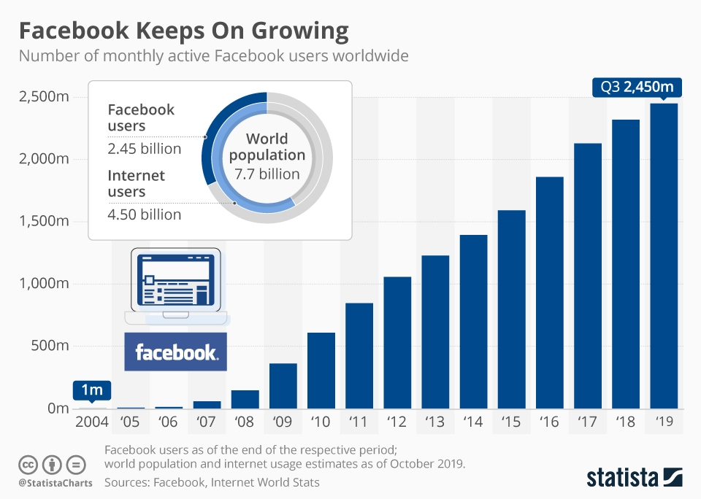
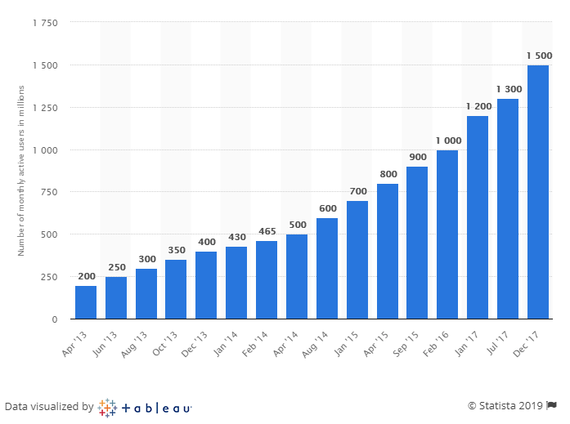
ECONOMIC MODELING
WhatsApp Vs. Facebook
2009: Facebook really get known with sufficient number of adopters then starts create further growth.
Critical mass phenomena
High diffusion rate

Slide 6
ECONOMIC MODELING
WhatsApp Vs. Facebook
Bandwagon effect
&
Diffusion
personal direct network effect
(Scale and embedded)
personal utility
Lock-In effect
Data network effect
-Breadth of content
-Human engagement
-real-time data
2 sided marketplace effect
customers - Advertisers
2 sided platforms
User - Developers
How network effects of Facebook and WhatsApp Affected the bandwagon effect
WhatsApp
FaceBook

Slide 7
THANK YOU
References
https://www.statista.com/chart/10047/facebooks-monthly-active-users/
https://digital.hbs.edu/platform-digit/submission/whatsapp-network-effects-worth-19-billion/h
Steve Lohr, Google, the new master of network effects; The New York Times . July 7, 2008

